Slide 1

Healthcare costs and mortality rate corralation

Slide 2

Proposal
The aim of our project is to identify trends in healthcare outcomes in the United States. This project will look to answer the questions of:
-Is there a relationship between healthcare costs and death rate by region?
-What are the most expensive/least expensive states to live in nationwide when it comes to healthcare?
-Are healthcare costs higher in states showing more chronic diagnoses?
We will be using the “Medical_cost_dataset” by Nandita Pore on Kaggle and the “Weekly Provisional Counts of Deaths by State and Select Causes, 2020-2023” gathered by the NCHS from the CDC
Kaggle:
https://www.kaggle.com/datasets/nanditapore/medical-cost-dataset?select=medical_cost.csv
CDC Statistics: https://data.cdc.gov/NCHS/Weekly-Provisional-Counts-of-Deaths-by-State-and-S/muzy-jte6/about_data
Github Repository: Dference/Project-3-Healthcare (github.com)

Slide 3
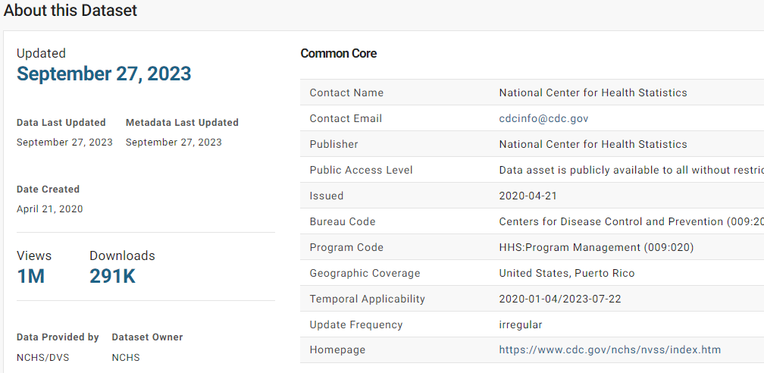

Slide 4


Slide 5

Heatmap to illustrate mortality rate by state

Slide 6
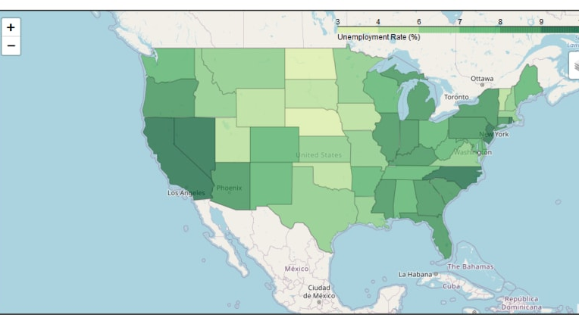
Chloropleth Map to show cost by region

Slide 7
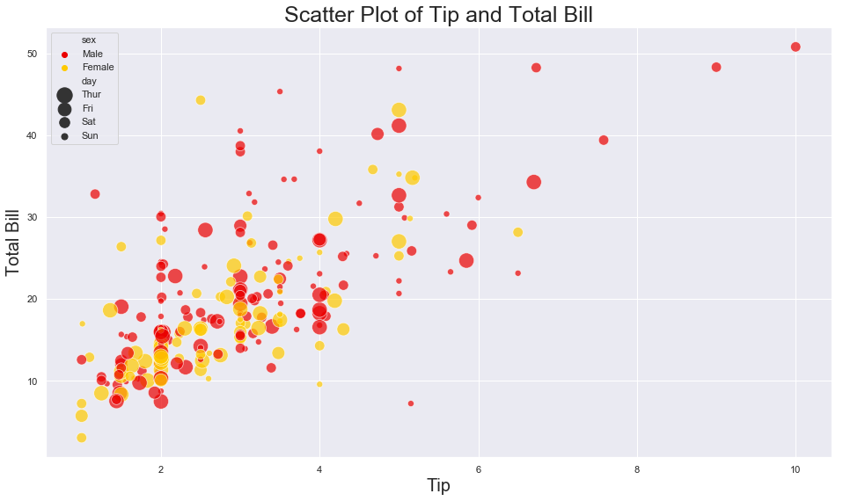
Scatter plot to show range of price comparison for chronic v non-chronic disease

